Slide 1

Scope

Slide 2

OneSupport Key Scope Reference Materials
Scope
  ★ Tax-Aide Scope Manual v1 TY15 10/09/15
  Tax-Aide Scope Summary v2 – 08/30/2015
Notes:
Scope Manual trumps all IRS documents Pubs 4012; Pub 4491
Scope Summary highlights differences between IRS pubs and Tax Aide items

Slide 3
OneSupport Key Scope Reference Materials
Policy/Tax Law
  Guidelines for Preparing Schedule C - 09/08/2015
Materials/Presentations
  TY15 NTTC Training Files Rel 1 - 10/15/2015
  Specialty Presentations Training TY14 (zip)
Notes:
Schedule C guidelines offer insights on preparing Schedule C regarding increased expenses and potentially new clients
Training Files are recommended to be at site for LC or counselor use
For reviewing particular topics if topic needs review to prepare clinet returns
Specialty Presentations address 1099-Misc fields and guidance on assisting clients regarding potential household employees when considering in home services: medical & possibility for itemized deductions; Conversely personal services payments are not valid itemized medical deductions; May be eligible for Dependent Care credit

Slide 4


Scope
In-scope tax law for Tax-Aide
Tax-Aide scope is national
  No local scope for slivers of the country
If a form or schedule or part of either is not explicitly in scope, it is out of scope
Tax-Aide scope is fixed at the beginning of each tax season
Notes:
These slides addresses comments and suggestions received over past few months:
Scope creep is an issue for some.
Training, certification, Volunteer Protection Act, etc. all become issues
We’re trying to help the majority of those taxpayers who need us – not every taxpayer
Scope Manual started as list of in-scope forms and schedules. Now includes most all forms and schedules counselor might see
Districts/states may decide that an in scope topic doesn’t apply or is more than they want to do – that’s okay
But flip side is that if not trained, then not in scope

Slide 5
Scope (cont.)
There is no requirement that every counselor must be taught all in-scope tax law
If a counselor was not trained on an in-scope tax law topic, that topic is out-of-scope for that counselor
Notes:
This slide addresses comments and suggestions received over past few months:
Requests for scope change for taxpayers in our neck of the woods because they are different. Scope creep is an issue for some.
Training, certification, Volunteer Protection Act, etc. all become issues
We’re trying to help the majority of those taxpayers who need us – not every taxpayer
Scope Manual started as list of in-scope forms and schedules. Now includes most all forms and schedules counselor might see
Districts/states may decide that an in scope topic doesn’t apply or is more than they want to do – that’s okay
But flip side is that if not trained, then not in scope

Slide 6
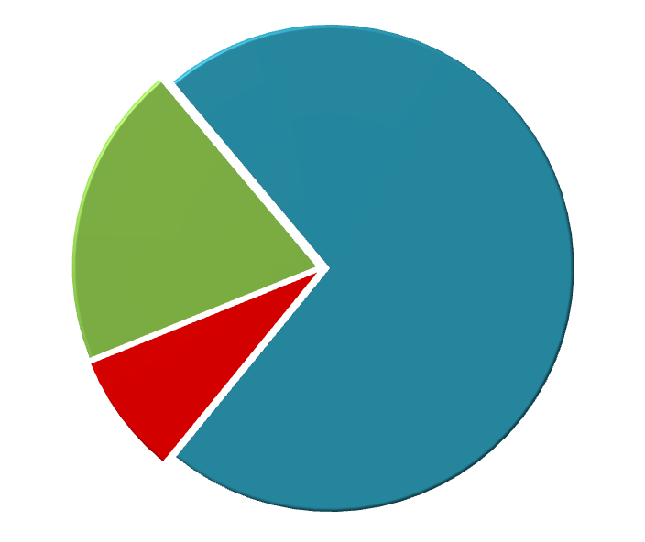
Scope Composition
Question for each Instructor team *– what do your volunteers need to know to service your taxpayers
  Core(Fundamentals)
  Comprehensive
  Changes –
  year-over-year
Core
Not
Applicable
Comprehensive
*DC/Lead Instructor/Instructor(s)/LC
In-scope Tax Law
Notes:
Question for each Instructor Team in a District - May vary by District
Fundamentals(Core) – what new volunteers need to know to service “typical” taxpayers and pass the test
Not applicable – In-scope tax law your local volunteers won’t see (state tax refund in no-tax state; RRB, certain brokerage items, e.g. K-1s for estates, Limited partnerships (passive activity) etc
Everything else(Comprehensive) – the remainder of in-scope tax law that volunteers will occasionally see
You are empowered to decide training topics based on your client base
Provides means to introduce limited topics to handle in their initial years of activity
Potentially eliminates the “FIRE HOSE” method of providing information for new volunteers

Slide 7
Scope - Approved
One requested change approved by IRS:
1099-R Code L (with 1, 4 or B) now in scope
  Loan treated as distribution
  Early distribution subject to 10% penalty
  Cannot be rolled over
Notes:
1 = early distribution;
4 = death benefit or survivor benefit to remaining spouse
B = Roth account and impact to owner, if early,

Slide 8
Pension Box 7 In-Scope Distribution Codes
7 | Normal Distribution (most common)
1 | Early withdrawal, no known exception, 10% additional tax
2 | Early distribution, exception applies
3 | Disability
4 | Death
6 | Tax-free Section 1035 exchange
Notes:
Code 6 is in scope for Tax-Aide only –distribution is nontaxable.
Code 1 only if the employee/taxpayer has not reached age 59 ½
Code 3 if under “normal retirement age” this may be reported as regular income
Code 4 Regardless of age of the employer/taxpayer to indicate payment to a decedent’s beneficiary, including estate or trust.
Also use if death benefit payment made by an employer but not madeas part of a pension, profit sharing, or retirement plan

Slide 9
Pension Box 7 In-Scope Distribution Codes
B | Designated Roth account distribution
F | Charitable gift annuity
G | Rollover not taxable, no additional tax applies
H | Rollover from a designated Roth account to a Roth IRA
L | Loan treated as a deemed distribution
W | Charges or payments for LTC contracts.
Notes:
Code B - A designated Roth account is one that is part of an employer plan, either a 401(k), 403(b) or 457(b) plan
Code H – A designated Roth account may be rolled into a Roth IRA. However it is not an IRA so the IRA box on the 1099-R will NOT be checked.
Code L is in scope for 2015. A deemed distribution usually occurs when a person leaves a 401(k) plan and has not repaid a plan loan. The distribution is treated like any other distribution except it cannot be rolled over and is not eligible for income averaging. If combined with code 1, the 10% early distribution penalty applies unless an exception applies. Exceptions are covered later.
Code W is in scope for Tax-Aide only – distribution is nontaxable and payment for LTC is not deductible.

Slide 10
Pension Box 7 In-Scope Distribution Codes
J | Early distribution from Roth IRA
T | Roth IRA distribution exception applies
 | .
Notes:
Code J - A designated Roth IRA account plan when no exception applies
Code T – A designated Roth IRA account if you don’t know if the 5-year holding period has been met but:
** the participant has reached 59 ½
** the participant died, or
** the participant is disabled

Slide 11
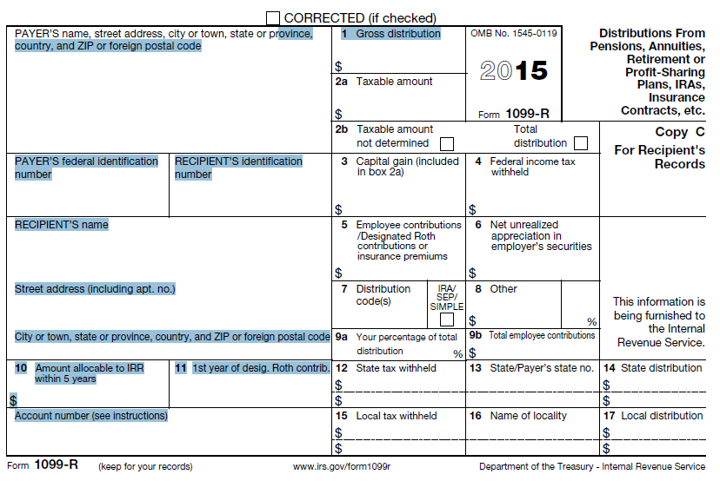
1099 R Form Box 7 Code L (1, 4, B)
( Early , Death , Roth )
Notes:
L = Loans deemed as a distribution when loan is not repayed

Slide 12
Additional Boxes on 1099 Forms
Out of Scope Updates
1099-INT
Box 10 Market discount (2014)
Box 11 Bond premium (2014)
Box 13 bond premium on tax-exempt bond (2015)
1099-OID
Box 5 Market discount (2014)
Box 6 Acquisition premium (2014)
1099-INT, 1099-DIV, 1099-OID, and 1099-MISC
FATCA filing requirement check box (2015)
Notes:
1099-INT Box 10: Discount if taxpayer made an election to include income as it accrues and notified pater of the election unless it was reported on Form 1099-OID
Box 11: amount of premium amortization allocable to interest payments which taxpayer did not want to amortize . NOT US TREASURY obligation
Box 13: premium amortization allocable to ta exempt interest payments
1099-OID
Box 5: amount of discount elected to include as income as it accrues
Box 6: amount of acquisition premium amortization that reduces the amount of OID that is included in interest on the tax return

Slide 13
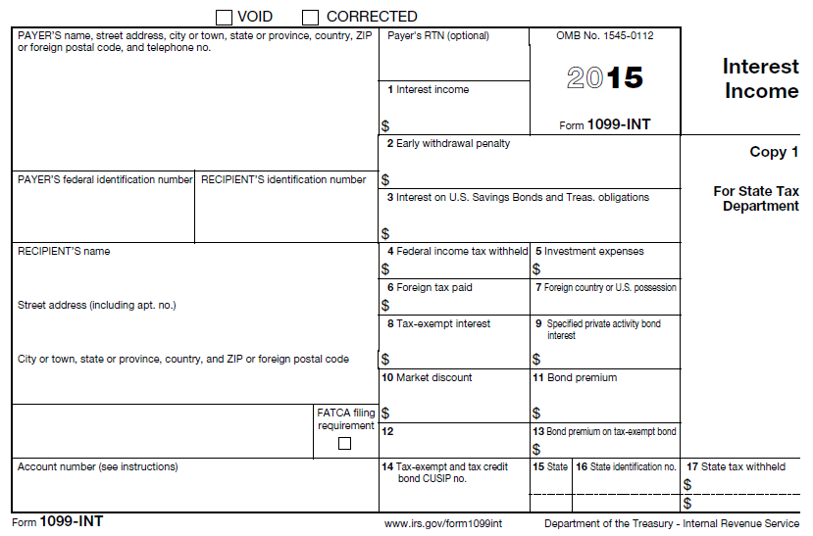
1099 INT Form (Box 10, 11, 13)
OUT OF SCOPE

Slide 14
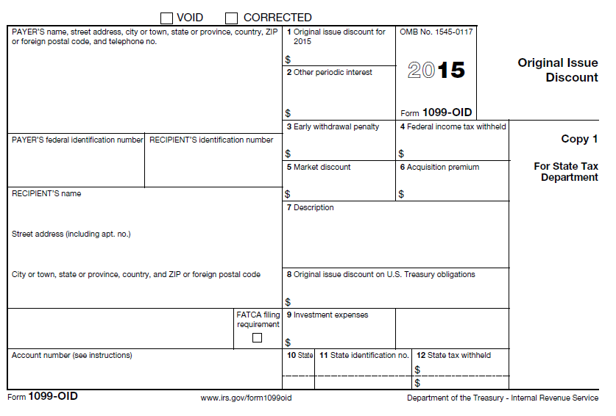
1099 OID Form (Box 5, 6)
OUT OF SCOPE

Slide 15
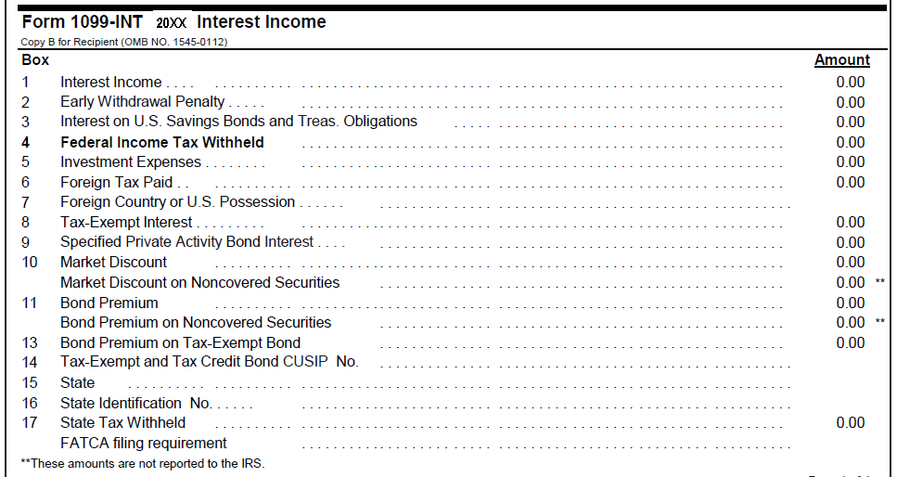
Interest Income
The Tax Form
Excerpt from sample brokerage statement
Lines 10-13 are out of scope
FATCA is out of scope
Notes:
Emphasize
All the information as in 1099-INT boxes
Format varies by payer

Slide 16
Additional Boxes on 1099 Forms…
Forms with entries or checks in these boxes are out of scope
  No IRS instructions
  Not in TaxWise
  FATCA (Foreign Account Tax Compliance Act) relates to Form 8938, which is out of scope
  Refer NTTC Training file #12
Notes:
There is also confusing information on what to do with information in these boxes. For example, the 1099-INT instructions for box 10 state to “Report this amount on your income tax return as directed in the instructions for Form 1040 or 1040A.” and the 2014 Form 1040 Instructions (2015 not available) state to “See the instructions on Form 1099-INT and Pub. 550.” and the Pub 550 instructions for box 10 state “Report this amount on your income tax return as directed in the instructions for Form 1040 or Form 1040A.” Collectively a bit circular.
Form 8938 is required when foreign financial assets exceed certain levels during the year or at year-end (thresholds depend on filing status) and must be filed with the 1040.

Slide 17
Foreign Interest Income/Account?
Must ask and answer questions at bottom of Sch B
  Foreign account/signature authority
  Foreign trust
If answer is “yes” to either, additional reporting may be required
Remind taxpayer of additional filing responsibility
Notes:
Emphasize
Usually the questions are defaulted to “no”
If there is foreign interest income, must ask the questions and correct the answers
A mutual fund that reports “foreign income” is not the same
Mutual fund interest income is in scope and is not a foreign account (normally)
Substantial penalties for not filing the foreign account forms: TD 90-22.1 and/or Form 8938 (both out of scope)

Slide 18
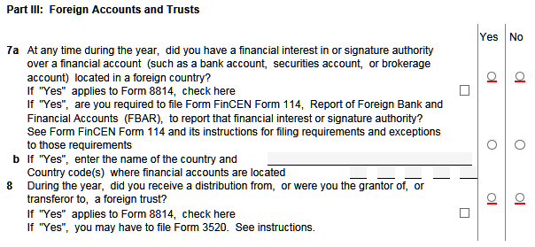
Limitations on Scope –
Foreign Accounts
Bottom of Sch B – Part III
OOS: 8938, 3520, 8814, FBAR(FinCEN Form 114)
Notes:
NOTE: NYS refunds have special checkboxes referencing refunds deposited in foreign accounts

Slide 19
VITA TCE Advanced Certification , Pub 4491, Pub 4012
TAX- Aide Differences

Slide 20
Identity Theft and $1 AGI Returns
On February 4, 2015, the IRS issued a Quality Site Reminder that included the following:
  Policy: SPEC VITA/TCE sites should not file $1 or $0 AGI returns just to e-file a state tax return. Taxpayers who have no Federal tax requirement should file their state tax return by paper or directly with the state electronically, if that option exists.

Slide 21
Identity Theft and $1 AGI Returns
Have recommended including $1 on federal return that would otherwise have a $0 AGI so that return could be
e-filed
  Flags return if there was an identity theft situation or marks SSN as “used” to prevent any later attempt at identity theft

Slide 22
Identity Theft and $1 AGI Returns
IRS software apparently flags $0 and $1 returns as possibly fraudulent which then requires a personal review
Tax-Aide decided to not issue this alert to the field so, by Tax-Aide policy regarding IRS alerts, it did not apply to Tax-Aide
Notes:
Logically, a low AGI return with no refund should not be so flagged, but changing software is not high priority in IRS budget.

Slide 23
TY2015 Tax-Aide Practice
Continue Tax-Aide practice of preparing $1 AGI returns and include in training materials – local SPEC or other IRS reviewers may take exception
Note: Identity Theft process will cover dependents

Slide 24
Tax-AIDE In Scope Summary vs VITA TCE/ Advanced
State tax refund from any prior year when it is clearly fully taxable or fully nontaxable
Sale of bonds that mature or are sold with no gain or loss or are reported on a brokerage statement with capital gain or loss only(no ordinary income/loss)
Notes:
IRS Pub 5220 VITA/TCE Volunteer Site Scope & Referral Chart

Slide 25
Tax-AIDE In Scope Summary vs VITA TCE/ Advanced
Schedule C expenses for renting equipment, other than a vehicle, for more than 30 days
Distribution from SIMPLE or SEP IRAs
Form 5329 Part VIII to waive penalty for failure to take Required Minimum Distribution

Slide 26
Tax-AIDE In Scope Summary vs VITA TCE/ Advanced
Form 1099-R codes 6,L, and W and codes J and T if distribution is non taxable
Form 1099-K for self employment(not rental income such as Airbnb)
Income from the rent of land reported on 1099-Misc or received as cash

Slide 27
Tax-AIDE In Scope Summary vs VITA TCE/ Advanced
Canadian or German social security income that is treated as US social security
Form 8283 to report non cash donations more than $500, but less than $5,0000
Form 1099-LTC and Form 8853 for Long Term Care Insurance payments

Slide 28
Tax-AIDE In Scope Summary vs VITA TCE/ Advanced
Form 1099-Q if entire distribution is used for qualified education expenses
Form 8606 Non Deductible IRAs Part I only
NOTE: Scope Manual trumps Pubs 4491 and 4012 for Tax-Aide
IRS Pub 5220 VITA/TCE Volunteer Site Scope & Referral Chart

Slide 29
Tax-AIDE Scope Summary vs VITA TCE/ Advanced
Out of Scope
  State/local unique topics set by regional or state leaders as out of scope due to complexity and/or lack of sufficient training
  Specific in scope tax law topics on which a counselor is not trained

Slide 30
NYS Volunteer Website Information
Helpful publications, forms, and Web links
Form TP-301, Income Tax Worksheet (2014)
Publication 93, NYS Personal Income Tax Modernized e-file (MeF) Guide for Return Preparers
Form TR-579-IT, New York State E-File Signature Authorization for Tax Year 2014
Form IT-201-V:9/14: Payment Voucher for Income Tax Returns
Publication TP-300, New York State Quick Reference Desk Guide
Publication 46, Common Reasons for Income Tax Adjustments
Online Services for Individuals
E-file information for individuals
Identity theft affecting your tax records
Notes:
NYS Volunteer website undergoing revisions
Form TP-301 should be used in conjunction with IRS Intake Sheet
Publication TP-300(electronic version) is the basis for volunteer program SCOPE
OTHER STATES filings requires additional training, other they are OUT of SCOPE

Slide 31
NYS Volunteer Website Information
Volunteer Income Tax Assistance and Tax Counseling for the Elderly test
Form TP-302, Test for Voluntary Income Tax Assistance Program
Form TP-302-A, Answer Sheet for Test for Voluntary Income Tax Assistance Program
Notes:
Logically, a low AGI return with no refund should not be so flagged, but changing software is not high priority in IRS budget.

Slide 32

Scope
Pending Federal “Extender legislation”
NYS ABLE ACCOUNTS

Slide 33
NYS Volunteer Website
Volunteer–
  Go to http://www.tax.ny.gov/volunteer
Notes:
Link and Learn
As part of our strategy to transition volunteer training to the electronic arena, we have marketed Link & Learn Taxes as the preferred method of training. We heard your feedback that the current structure of Link & Learn Taxes was not appealing for individual or classroom use.
Link & Learn Taxes, linking volunteers to quality e-learning solutions, is the web-based program providing nine courses: Basic, Intermediate, Advanced, Military, International, Puerto Rico and Foreign Student, along with a refresher course for returning volunteers. This year there are two optional specialty courses on Cancellation of Debt and Health Savings Accounts. This training prepares SPEC partners and volunteers to provide quality tax return preparation services in their local communities. This fun, interactive course teaches the basics to accurately prepare income tax returns for individuals AND users can obtain volunteer certification along the way at their own pace!

Slide 34

Scope
Questions…
Comments…

