Slide 1
AARP Foundation Tax-Aide OneSupport Help Center

Slide 2
OneSupport Help Center
All information pertaining to the AARP Foundation Tax-Aide program, including training materials, communications, policy, and procedures, is housed within the OneSupport Help Center (OSHC).
The OneSupport Help Center is maintained by the AARP Foundation Tax-Aide National Office staff and volunteers

Slide 3
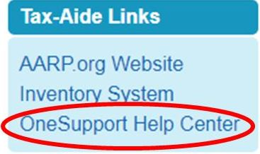
Accessing the OneSupport Help Center
The OneSupport Help Center is accessed through Volunteer Portal: volunteers.aarp.org
Click on the OneSupport Help Center link in the left sidebar from the Portal Homepage and it will open in a new window

Slide 4
Navigating the Help Center
There are Two Options for Searching within the Help Center
Volunteers can choose between using the search bar or the category tiles.
Search Bar
The search bar is typically used if the location of the information being searched is not known
Category Tiles
Category tiles are used when volunteers know where to find the desired information.

Slide 5
Search Bar
To find information using the search feature:
Enter keywords or phrases in the Search bar in the upper right hand corner of the page that pertain to the information you are seeking.
Click the magnifying glass to the right of the Search bar.
From the list returned, click on the item you wish to view.

Slide 6
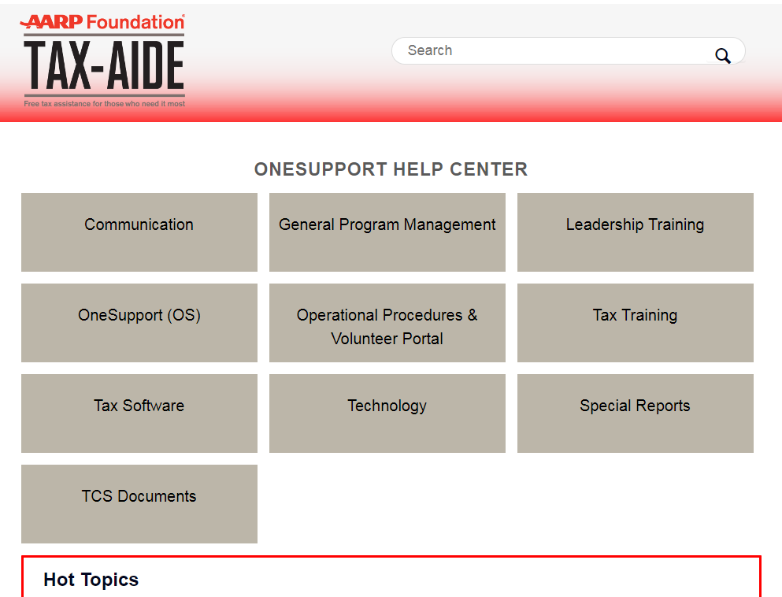
Category Tiles
To find information using the Category Tiles
Click on the category tile that corresponds to the information for which you are searching.
Click on the section title that aligns with your search.
Click on the article you wish to view.

Slide 7
Submitting a Request
“Submit a Request” (Ticket)
Volunteers should consult their supervisors with support and “How to…” questions before submitting a request. For all other questions, they should use “Submit a request” via the OneSupport Help Center. Doing so will create a ticket that will be addressed by volunteer or staff subject matter experts. Issues should be submitted separately for faster response time.
All technology issues should be addressed using this function as it will ensure that the request is seen
Please do not send an email directly as the only way of requesting support, as there is a chance it will be missed

Slide 8
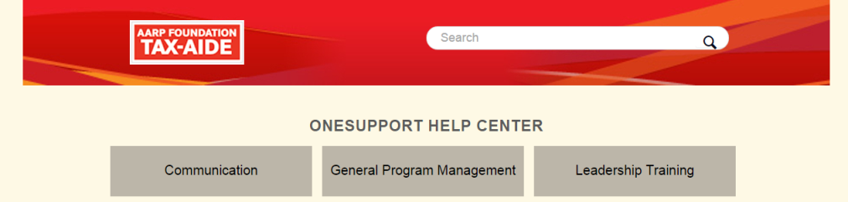
How to Submit a Request
Navigate to the OneSupport Help Center.
Click on the “Submit a request” link above the Search bar.
Select a category that best describes your inquiry from the drop-down menu.
Fill out the appropriate fields, adding any relevant attachments.
Click the Submit button. An email will be sent to you confirming that your ticket has been received into OneSupport.

Slide 9
How to Submit a Request (cont’d)
Select a category for your inquiry by clicking on the drop-down arrow
Select a category that best describes your inquiry from the drop-down menu.
Fill out the appropriate fields, adding any relevant attachments.
Click the Submit button. An email will be sent to you confirming that your ticket has been received into OneSupport.

Slide 10
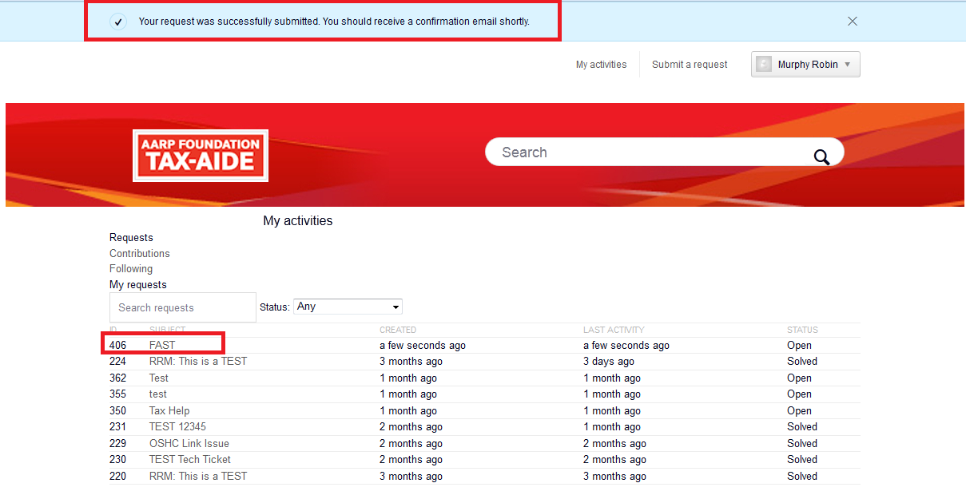
How to Submit a Request (cont’d)
Upon submission, you will be directed to the “My Activities” view where you will see a confirmation window near the top and your ticket new ID number under My request.
You will also receive a standard communication via e-mail shortly after submitting a ticket. An expert will get back to you within 24 hours.

Slide 11
Expert Groups
Expert Groups
Specific Tax-Aide volunteers, committee members and National Office staff make up the “Expert Groups” – i.e. - NTC = Expert Group
Each group is comprised of committee members National Office staff and volunteer experts who have the tools necessary to resolve a request. Individual members of these groups are called “Agents”.

Slide 12
Technology Forms and Subtopics
Form | Subtopic
Technology Admin/Policy | Administrative Question Tax-Aide Policy
Technology Hardware | Asset Tags Computer Scan Consumable Order Questions or Problems IRS Depot Orders Online Inventory System Repair and Replace
Technology Networking | Hot Spots Printer Network Network Setup Setup Wireless
Technology Software | How to install Image How to obtain Image Operating System Other Software Request for Image Disk Security TIA agent
Tax Software | Software General Question Tax Incidents Escalation Tax Software Orders
Technology Other | Should only be used if does not fit any of the groups above

Slide 13
Additional Information
Additional Information can be found in OneSupport Help Center

Slide 14
Questions?
QUESTIONS??

