Slide 1
AARP Foundation Tax-AIDE
2017 District Coordinators Meeting

Slide 2
Topics
NOC Reorganization
OneSupport Process Change
Portal Changes
Best Practices
OneSupport Help Center
Hands on Portal Use

Slide 3
NOC Reorganization & Restructuring
Notes:
Says it all

Slide 4
NOC Reorganization
Aligns Committee with function of all other AARP Foundation Tax-Aide Committees
Function vs Position
Working vs Advisory
Transfer Functions to Volunteers currently done by staff

Slide 5
NOC Reorganization
Working Groups
One Support – System Maintenance
One Support – Agent Support
Operational Systems
Training
Portal
RAA, PVS, ADS

Slide 6
NOC Reorganization
Change impacts Committee, Staff and those that interact with NOC
No Policy impact
No local, district or state impact
Recruitment for Working Groups
September ADS Webinars
SC will be consulted

Slide 7
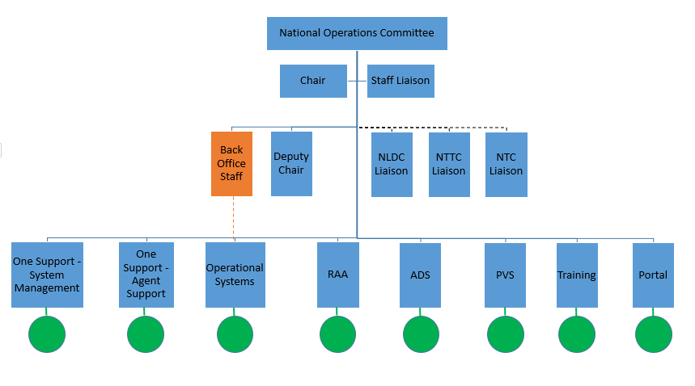

Slide 8
OneSupport Agent Support Structure
Notes:
Says it all

Slide 9
OneSupport Agent Support
NOC agents processed almost 7000 volunteer questions in TY2016
We need to:
Provide service without undermining supervisor responsibility
Allow unique state processes
Encourage use of OneSupport

Slide 10
OneSupport Agent Support
Change impacts all Volunteer Roles
Supports and reinforces 2017-2018 Policy and Procedures Manual Section 11.3.1 Communication and supervisor hierarchy

Slide 11
OneSupport Agent Support
Communication and supervisor hierarchy
Enforces policy
Quantifies knowledge gaps allowing for better local training
Allows unique state processes
Builds community

Slide 12
OneSupport Agent Support
Volunteer who sends Email to taxaide@aarp.org
Generic Response
Communication Hierarchy
Use ‘Submit a Request’ via Portal

Slide 13
OneSupport Agent Support
‘Submit a Request’ via the Portal
Auto triaged by Form and Subtopic

Slide 14
OneSupport Agent Support
‘Submit a Request’ via the Portal
Auto triaged by Form and Subtopic
Answered in Normal business hours
Adjusted for time zone of agent
No weekends

Slide 15
OneSupport Agent Support
‘Submit a Request’ via the Portal
From SMT or higher, questions will be answered.

Slide 16
OneSupport Agent Support
‘Submit a Request’ via the Portal
From Local and District volunteers, with supervisors copied, questions will be answered.
From Local and District volunteers, with NO supervisors copied, questions returned unanswered.

Slide 17
Comments?
Questions?
Concerns?

Slide 18
Volunteer Portal Development
Notes:
Says it all

Slide 19
Enhancements Delivered in Releases 3.1/3.2
117 enhancement stories delivered in Releases 3.1/3.2
Large focus on
Expenses and Stipends
Vol Communications
Vol Lifecycle Mgmt
Does not include over 200 bug fixes or data corrections.
Notes:
- Jan through Aug = 8 months = ¾ year = 274 days. 274/117 = 1 new feature roughly every 2 days
Testament to all involved, including dev, QA, business partners (for requirements, UT, etc), org readiness, CoE
Includes 32 enhancements delivered by the CoE
50 total “Passed to CoE”
32 delivered
6 in progress
12 not delivered
retracted or implemented via a business process change or reporting solution

Slide 20
Portal: Categories of Improvement
Automation of Manual Processes
Business Rules and Security
Reimbursements
Reporting
Recognition and Rewards
Portal Access
Volunteer Communications
Volunteer Lifecycle Management

Slide 21
Portal: Categories of Improvement
Release Notes are available on OneSupport before date of release
Minor & Major releases included
Announced in SMT Roundup
Outages noted in Message area and SMT Roundup

Slide 22
 | Release 3.0 - 3.1.6 through July 2017 | Release 3.2 August 2017
New Features | Exit Surveys Personal Data Change Notification IRS Certification Phase 1 Donated Funds Process State Cap Process | IRS Certification Phase 2 Emails when a new Prospect is added Automation Prereq. for Chatter
Enhancements | Automation of Processes Years of Service Initial Portal Access One Day Sites Deceased Volunteer Workflow | Delete Duplicate Records All Volunteer Emails
Usability | Help Text Check Image Reimbursement Entry and Fields Account Activity Visibility Data Errors | Add Site name to Reimbursements Bug Fixes

Slide 23
 | Release 3.0 - 3.1.6 through July 2017 | Release 3.2 August 2017
New Features | Exit Surveys Personal Data Change Notification IRS Certification Phase 1 Donated Funds Process State Cap Process | IRS Certification Phase 2 Emails when a new Prospect is added Automation Prereq. for Chatter
Enhancements | Automation of Processes Years of Service Initial Portal Access One Day Sites Deceased Volunteer Workflow | Delete Duplicate Records All Volunteer Emails Reports & Dashboards
Usability | Help Text Check Image Reimbursement Entry and Fields Account Activity Visibility Data Errors | Add Site name to Reimbursements Bug Fixes

Slide 24
Personal Data Change Notification
Addresses Data Security Issues
When personal info is changed, volunteer is notified by email.
Who changed
What changed

Slide 25
Personal Data Change Notification
State Concerns:
Who in your state will be making changes?
What notifications are needed to make a change?

Slide 26
Personal Data Change Notification
BEST PRACTICE:
Volunteer makes their own changes to personal information.
Direct Deposit Information

Slide 27
Automation of Processes
Automation of processes:
Lessens the possibility of errors
Changes responsibilities
ADS is not the only data manager
Administrative tasks by District / Local level volunteers
Volunteer responsible for their own

Slide 28
Automation of Processes
Automation of processes:
Lessens the possibility of errors
Changes responsibilities
Creates opportunities
Volunteers who do not do tax returns
Leadership transitions

Slide 29
Automation of Processes
Automation of processes:
Lessens the possibility of errors
Changes responsibilities
Creates opportunities
Balances responsibilities

Slide 30
Automation of Processes
Deceased Volunteers
Permissions and access when assignments change
Program Volunteer and Volunteer Assignment status’ are tied

Slide 31
Automation of Processes
Best Practice
Get the responsibility as close to the activity as possible.
Volunteer maintains personal data
LC maintains site and prod info
DC / AC maintains assignments
ADS deals with sites, oversight, training

Slide 32
Years of Service
Years of Service is available in Program Volunteer Record and on Reports
Net Years Served: The total amount of time served. Uses assignment start and end dates and subtracts gaps in service.
Years of Service: The amount of time elapsed since volunteer joined. Elapsed time from the Program start date in the Program Volunteer record.

Slide 33
Years of Service
As of 9/21/2017

Slide 34
Years of Service
2017 – 18 Policy manual Section 11.7.2.3
“Annual determination of volunteer service award recipients is based upon the Net Years Served field in the Volunteer Portal volunteer record. AARP Foundation accepts prior service with VITA, or another free tax preparation service, though this may require the ADS to make manual adjustments to a volunteer’s Program Volunteer record.”
Presentation before the service year or after is a state choice

Slide 35
Years of Service
Best Practice:
ADS responsible for ordering awards (process unchanged)
ADS responsible for altering volunteer records to credit service in other programs

Slide 36
New Prospect Email Notification
When a Prospective Volunteer submits a Tax-Aide Application:
New Contact record added
Email notifications sent to:
PVS
District

Slide 37
New Prospect Email Notification
States determine to which district Prospective Volunteers in specified zip codes are routed.
Report available showing current routing

Slide 38
New Prospect Email Notification
Best Practice:
Routing should be reviewed annually AND when district changes occur
Routing changes are requested by ADS OR SC through OneSupport Submit a Request

Slide 39
Add Site Name to . . . .
We have heard the hue and cry
S50052701
TA-R06-MN1-D01- S50051507
TA-R06-MN1-D01- S50051507
S50051725
S50051727
S50051912
TA-R06-MN1-D01- S50051521
S50052525
S50051725

Slide 40
Add Site Name to . . . .
Volunteers need to know site names to be able to correctly maintain data in the portal.
TA-R06-MN1-D01- S50051507 is not helpful or understandable

Slide 41
Add Site Name to . . . .
Site name has been added to
Reports
Records
Screens
throughout the portal

Slide 42
Add Site Name to . . . .
On Reimbursement Assignment selection screen

Slide 43
Add Site Name to . . . .
On Volunteer Assignment screens

Slide 44
Add Site Name to . . . .
On Pre-Approvals

Slide 45
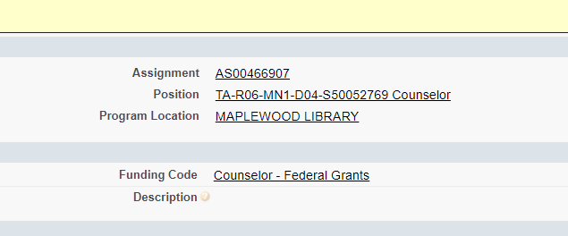
Add Site Name to . . . .
On Reimbursements

Slide 46
Add Site Name to . . . .
There may be places where you still do not see site name
Let us know!
OneSupport>Submit a Request

Slide 47
 | Release 3.3
New Features | Rewards and Recognition New Volunteer Program Standup – Purpose Prize Learning Management System
Enhancements | IRS Certification Phase 3 Escalation Emails Volunteer Management Automations Time Entry changes
56 enhancement stories are currently planned for Rel 3.3
NOTE:
Planned features are subject to change based on level of effort and business needs for all AARP Programs.

Slide 48
Comments?
Questions?
Concerns?

Slide 49
OneSupport Help Center
Notes:
Says it all

Slide 50
Portal Walkthrough
Notes:
Says it all

Slide 51
Comments?
Questions?
Concerns?

